Slide 1
Escape from N2 Planet - N2 Team -
Resource List
◈ Table of Contents
Character
Object
Effect Character
Effect Object & Item
Animation Character Tom
Animation Character Jane
Animation Character Zombie
Sound

Slide 2
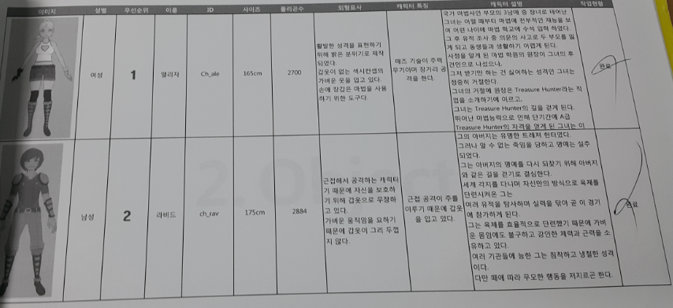
Character 예시

Slide 3
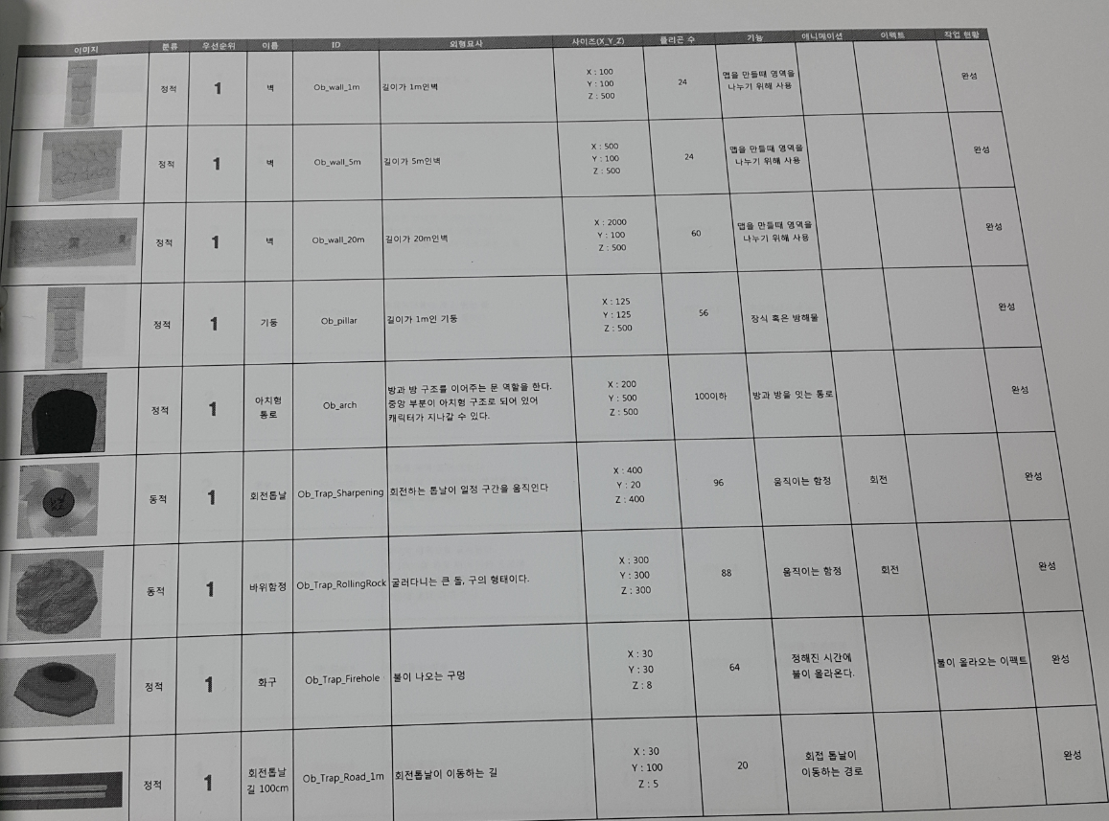
Object 예시

Slide 4
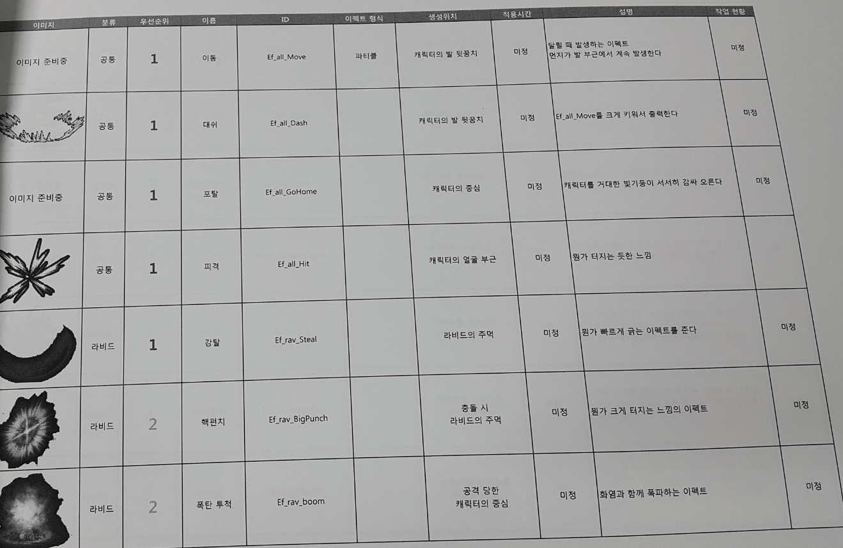
Effect Character 예시

Slide 5
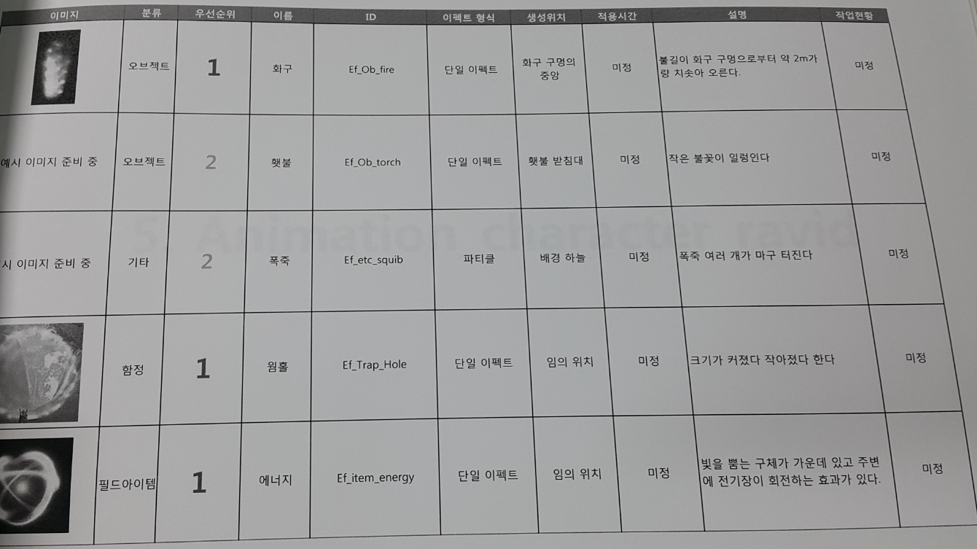
Effect Object & Item 예시

Slide 6
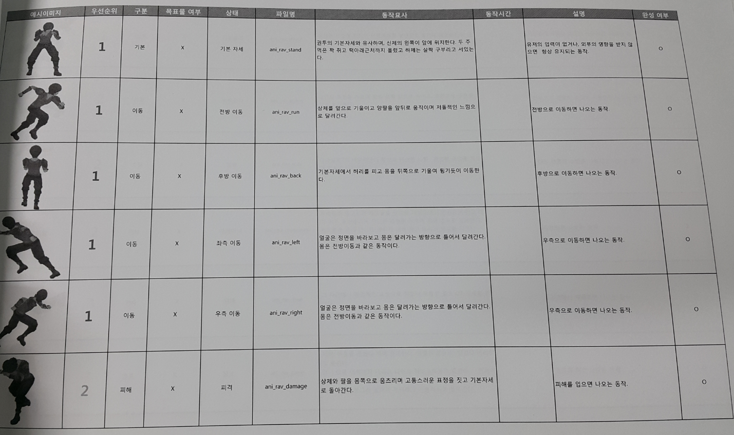
Animation Character 예시

Slide 7
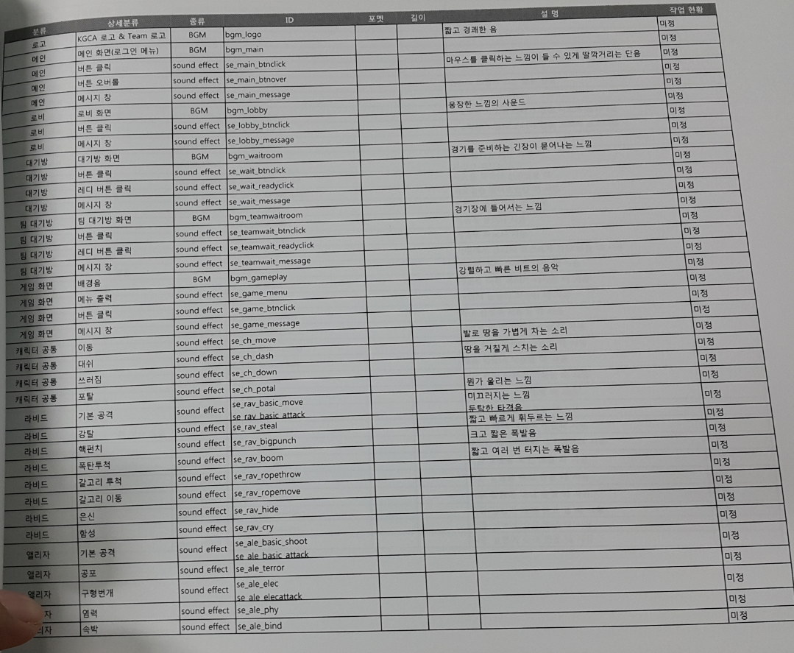
Sound 예시

